Slide 1

E-Voting System – A Safe and Convenient Way to Cast Votes Online
Group Members: Km Anjali Sagar(2300290140091) Himanshi Chopra(2300290140075)

Slide 2
Project Abstract
Overview
Key Objectives
Approach
The Online Voting System is a secure and convenient digital platform that allows users to cast their votes remotely, ensuring transparency, accessibility, and fraud prevention in the election process.
Enhance voter participation, eliminate manual errors, and provide a reliable, tamper-proof voting mechanism using authentication and encryption.
Implement user authentication, secure vote casting, real-time result tracking, and an intuitive interface to ensure a seamless voting experience for all users.

Slide 3
Project Goals and Objectives
Fair Voting Process
1
Ensure a transparent and accessible voting system for all participants.
2
Informed Decision-Making
Provide voters with clear and unbiased information about candidates and policies.
Community Engagement
3
Encourage active participation and discussions to make elections more inclusive.

Slide 4

Alignment with UN Sustainable Development Goals (SDGs)
SDG 5: Gender Equality
SDG 9: Industry, Innovation, and Infrastructure
Empowers women and marginalized communities by improving access to voting.
Enhances digital infrastructure for secure and efficient online voting.
SDG 16: Peace, Justice
SDG 11: Sustainable Cities
Reduces election fraud and ensures integrity in the voting system.
Enables inclusive participation in elections, even in remote or urban areas.

Slide 5





Methodology and Approach
Understand Voters Needs
Identify key challenges in online voting, such as accessibility, security, and transparency.
Design Secure and User-Friendly System
Develop an intuitive interface with multi-layered authentication for a seamless voting experience.
Ensure Voter Trust and Community Engagement
Implement transparent election procedures and real-time vote verification to boost confidence in the system.
Track and Analyze Election Data
Use analytics to detect patterns, prevent fraud, and improve future election processes.

Slide 6




Expected Outcomes and Impact
Community Engagement
Voter Accessibility
Election Security
Encouraging civic participation through a user-friendly and reliable voting system.
Broader access to voting for remote and differently-abled voters.
Enhanced transparency and security in online voting processes.

Slide 7

Key Project Deliverables
Secure Voting Platform
A user-friendly, encrypted system ensuring secure online voting.
Voter Authentication
Multi-factor authentication to verify voter identity and prevent fraud.
Real-time Vote Tracking
Transparent vote counting with real-time tracking and result updates

Slide 8
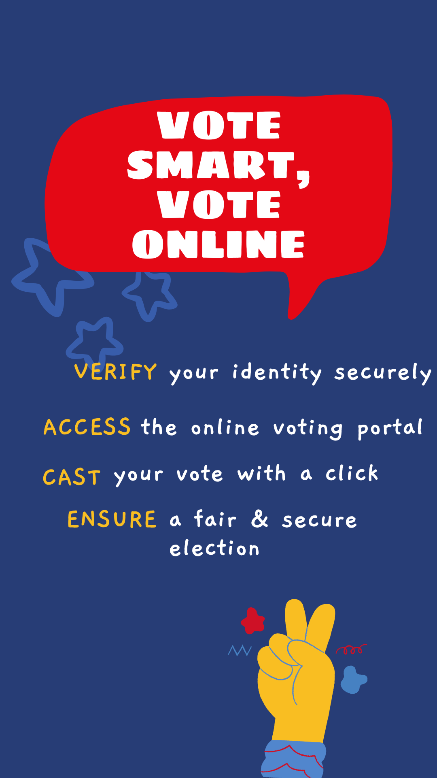
Next Steps and Conclusion
1
System Development
2
Voter Accessibility
Finalize security protocols, test encryption, and ensure seamless user authentication.
Enhance UI/UX to make online voting easy for all, including differently-abled users.
3
Scale and Security
Expand the system for nationwide elections while strengthening cybersecurity measures.

